Slide 1
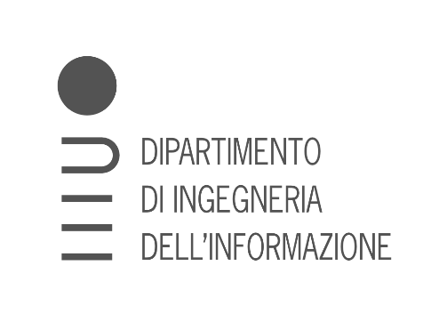
Unicycle project

Slide 2
Outline
Introduction
Framework
Diff. Flatn L & NL
Outpput state
parking

Slide 3
Intro

Slide 4
Framework

Slide 5
TRAJECTORY TRACKING - STATE ERROR FEEDBACK

Slide 6
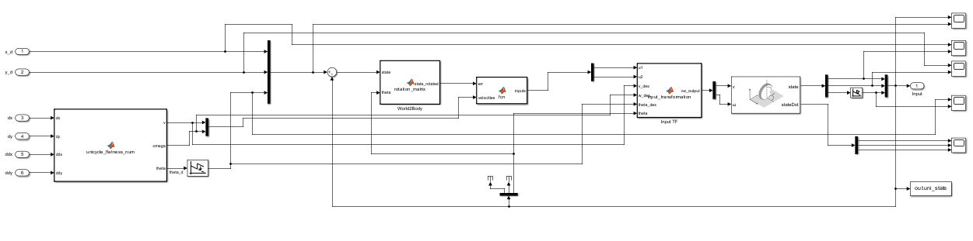
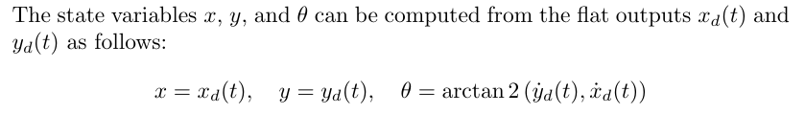
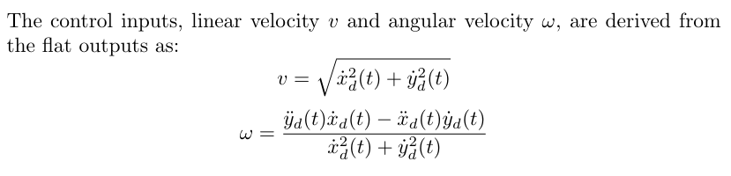
Linear case
Explain that we can not guarantee asymp convergence cause system TV, but we do have convergence property cause we are doing rectilinear and semicircular motions so someway we are covered by good convergence properties
explain also the wrap / unwrap thing ?
General overview --> explain the general strcuture, all the blocks and why

Slide 7
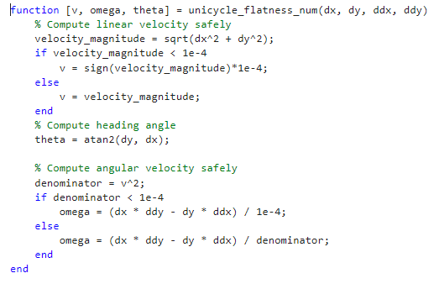
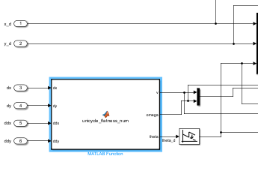
Avoiding division by zero

Slide 8
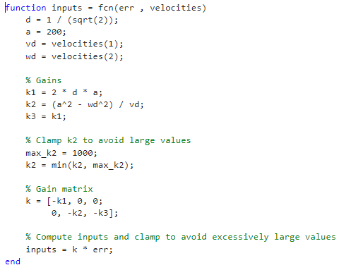
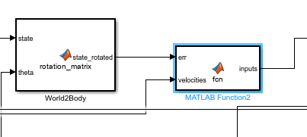
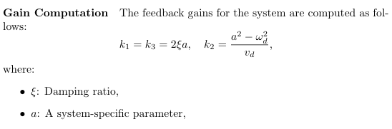
Gains and parameters --> gains: also plot where they lives ?

Slide 9
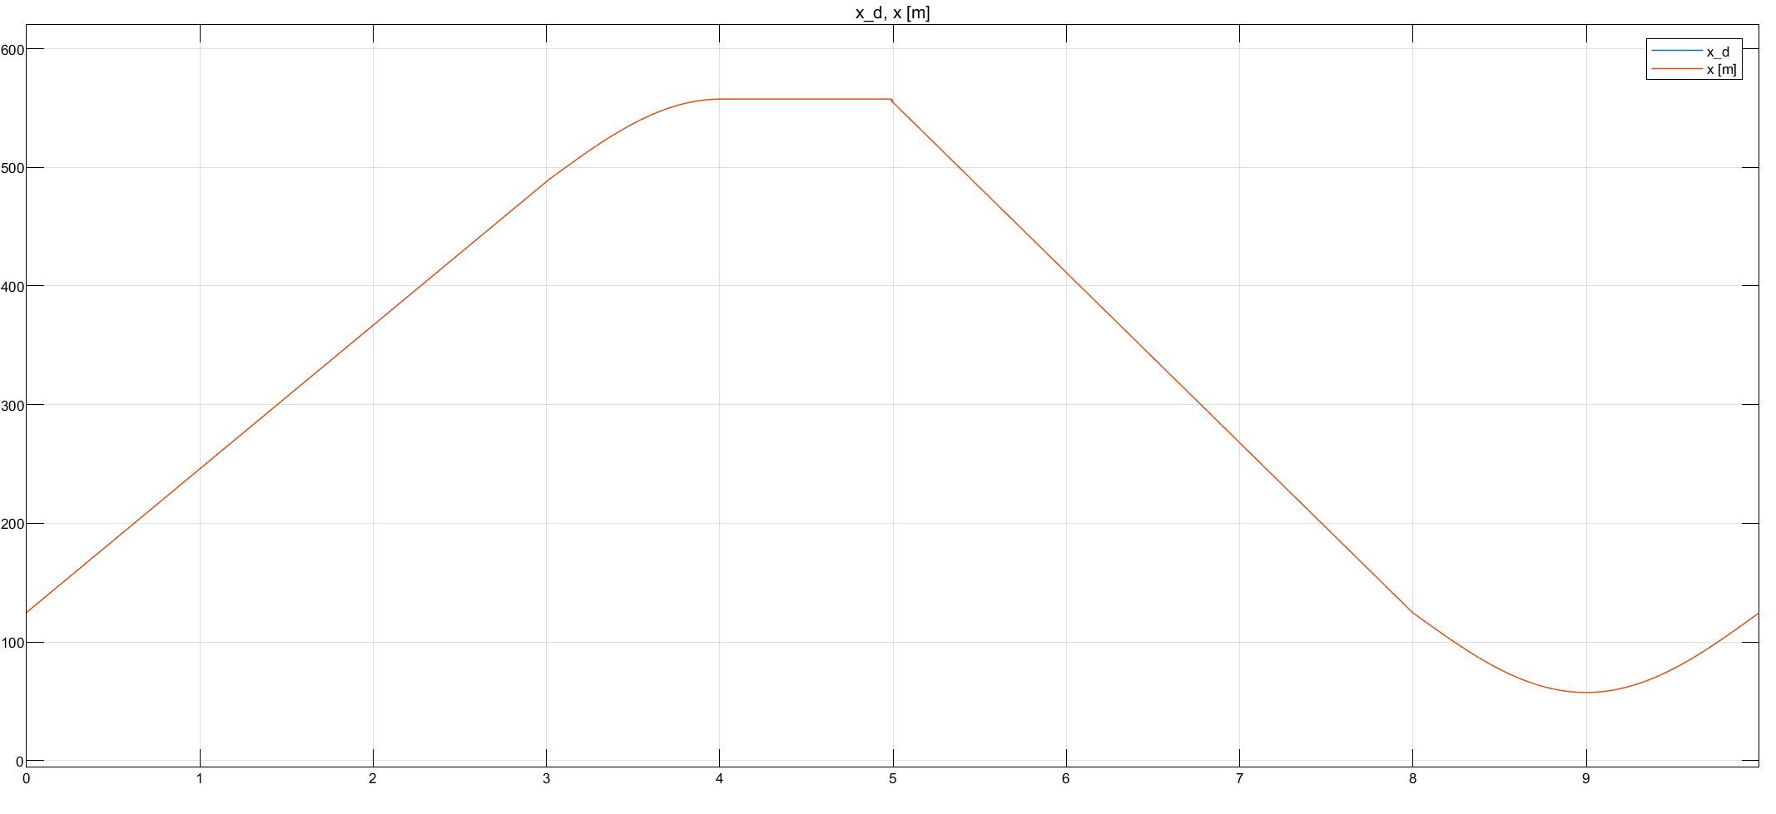

Slide 10
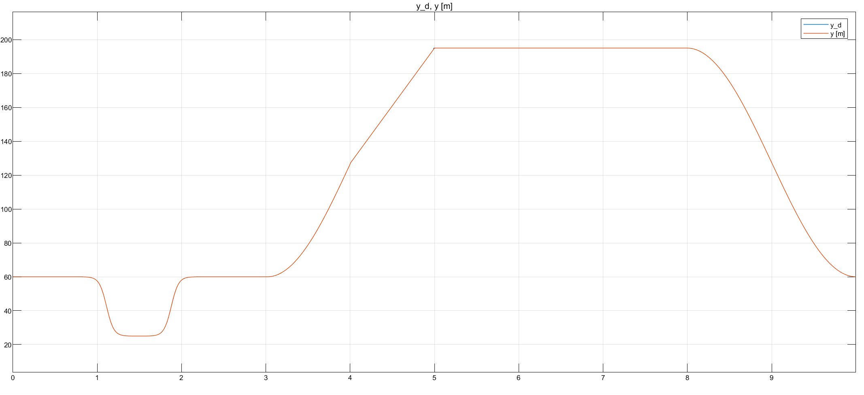

Slide 11
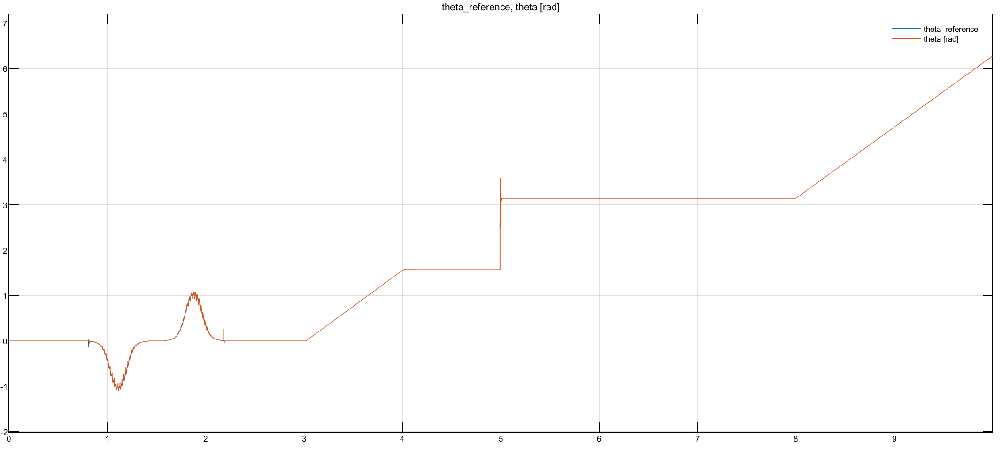
Cambia theta_ref in theta_d o cambia x_d , y_d e controlla che siamo giusto lineare questo grafico

Slide 12
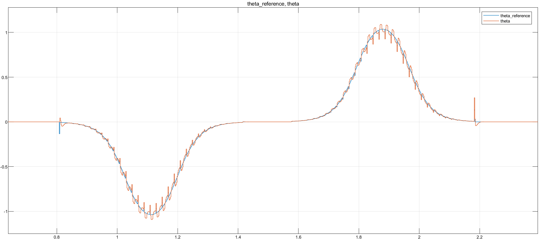

Slide 13
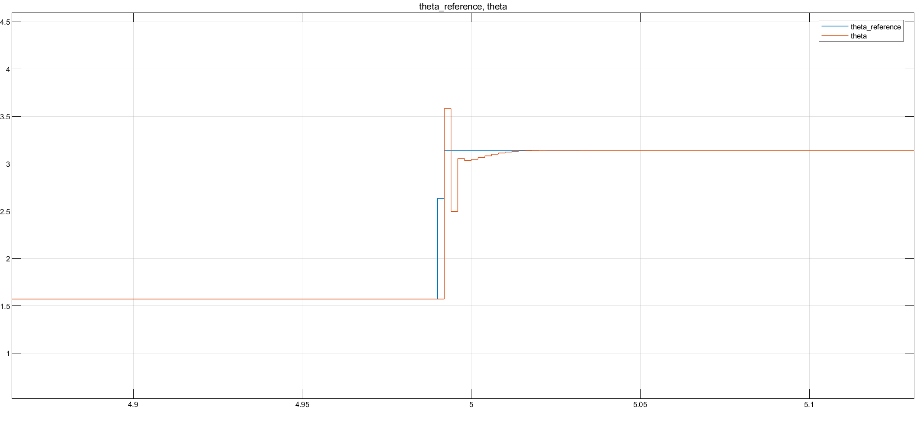
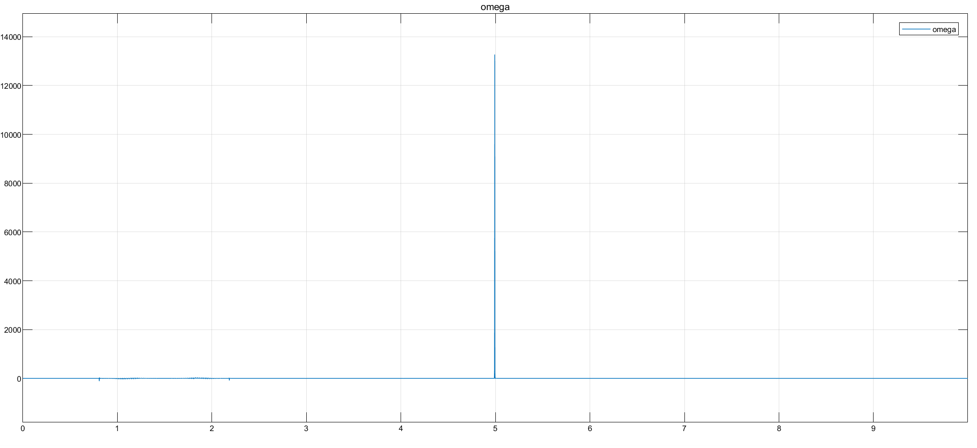
Focus on sharp curve
As expected from theory, differential flatness block should not be able to compute the input velocities when reaching a non differentiable part of the trajectory. Indeed, impulses in both velocities arises, with stronger effect in omega, (its computation is based on the second order derivative).
Nonetheless, thanks to Simulink implementation of the derivative we have been able to overcome the problme and to finish the simulation anyway.

Slide 14
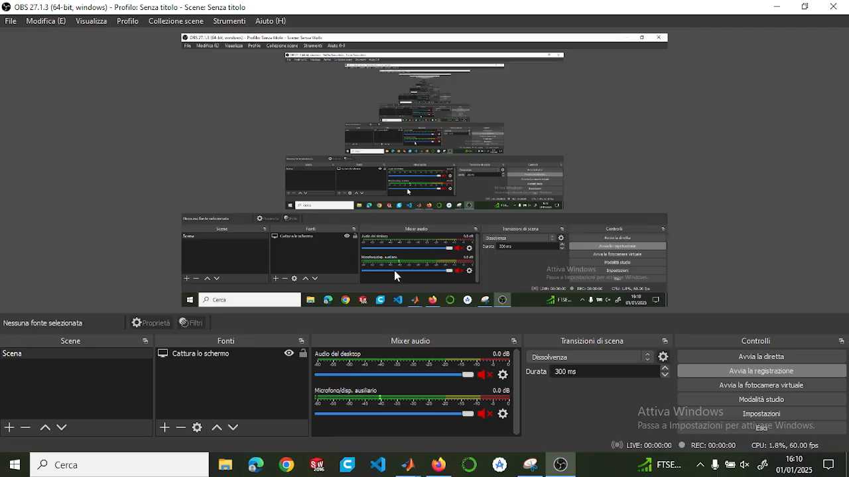
Video
Sistemare e tagliare video

Slide 15
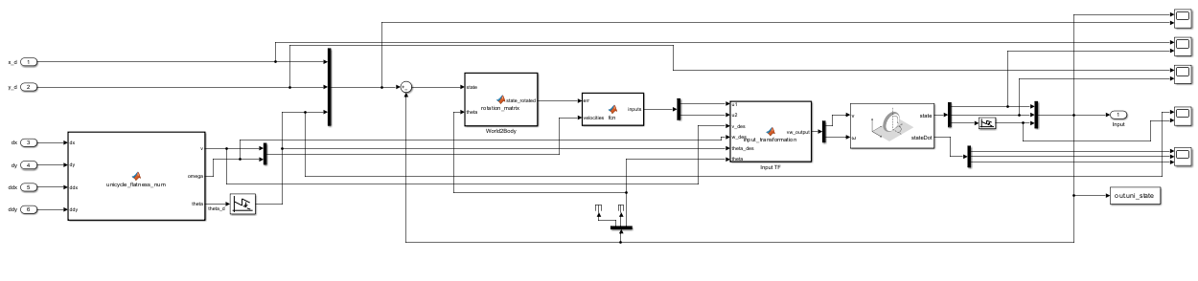
Non Linear case
NON LINEAR controller --> same structure , security checks … but different gain computations
explain also the wrap / unwrap thing ?
General overview --> explain the general strcuture, all the blocks and why

Slide 16
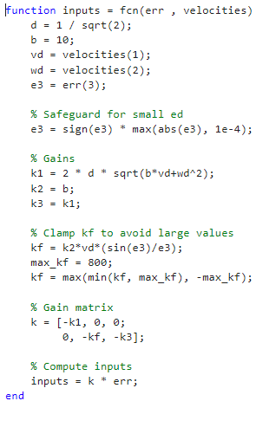
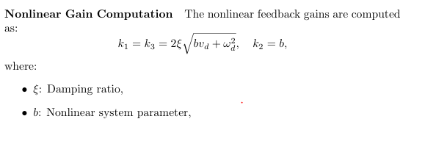
Gains and parameters

Slide 17


Slide 18
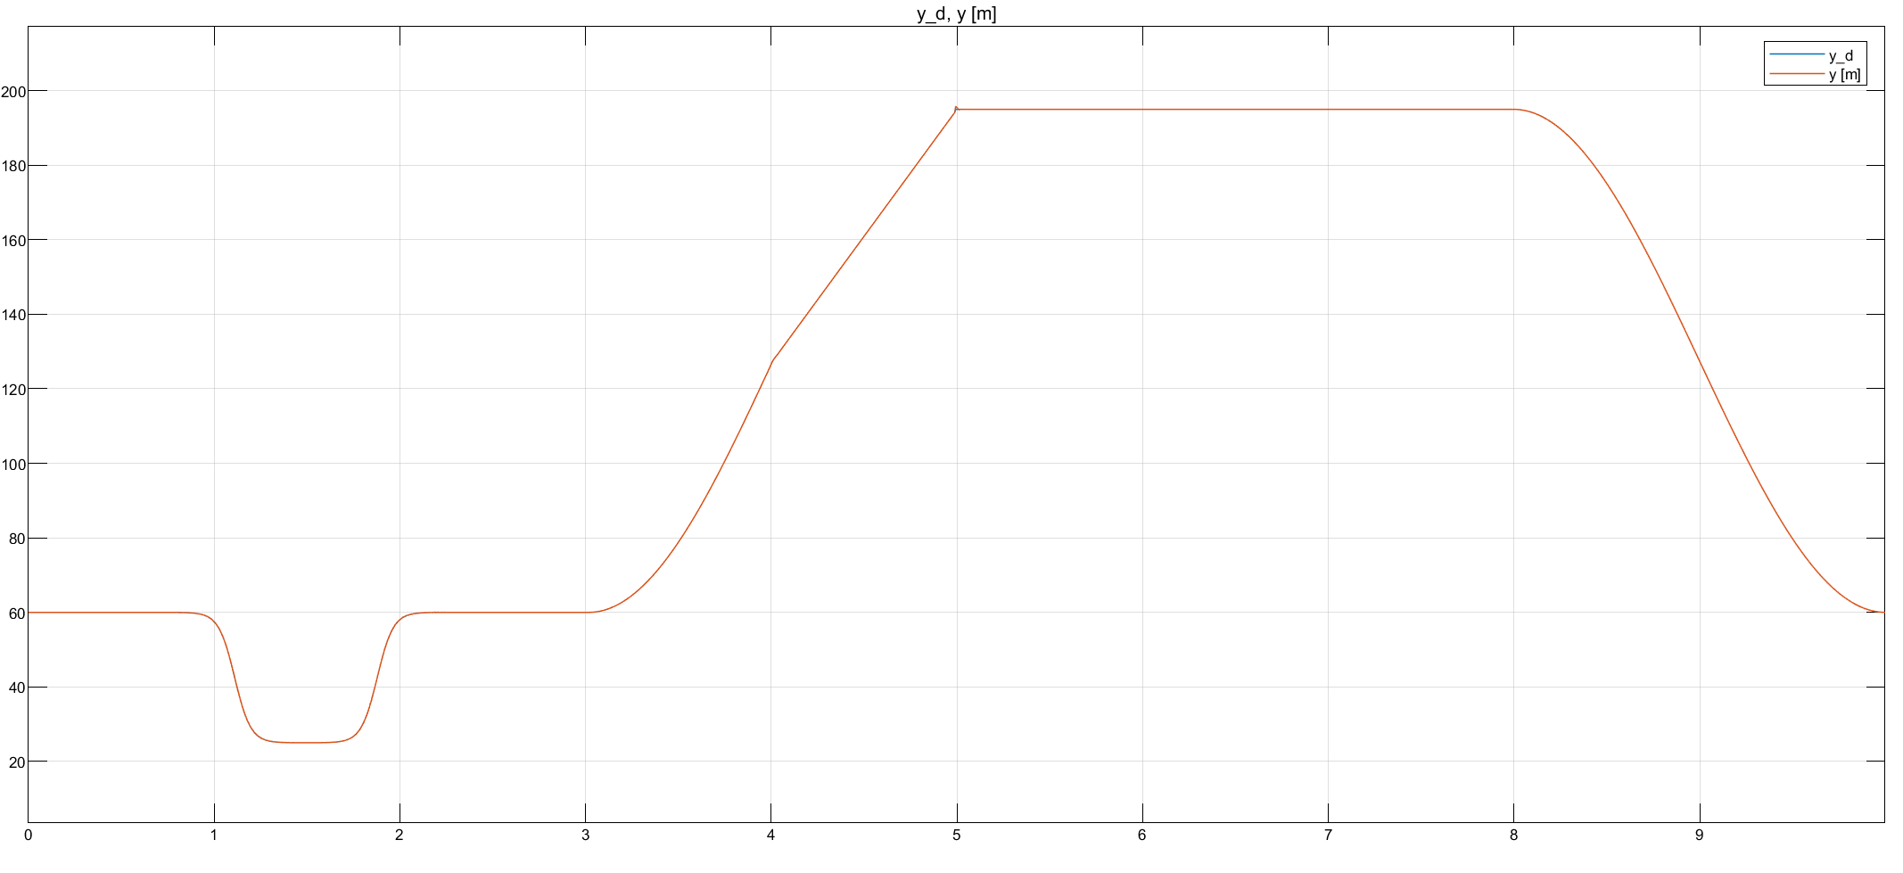

Slide 19
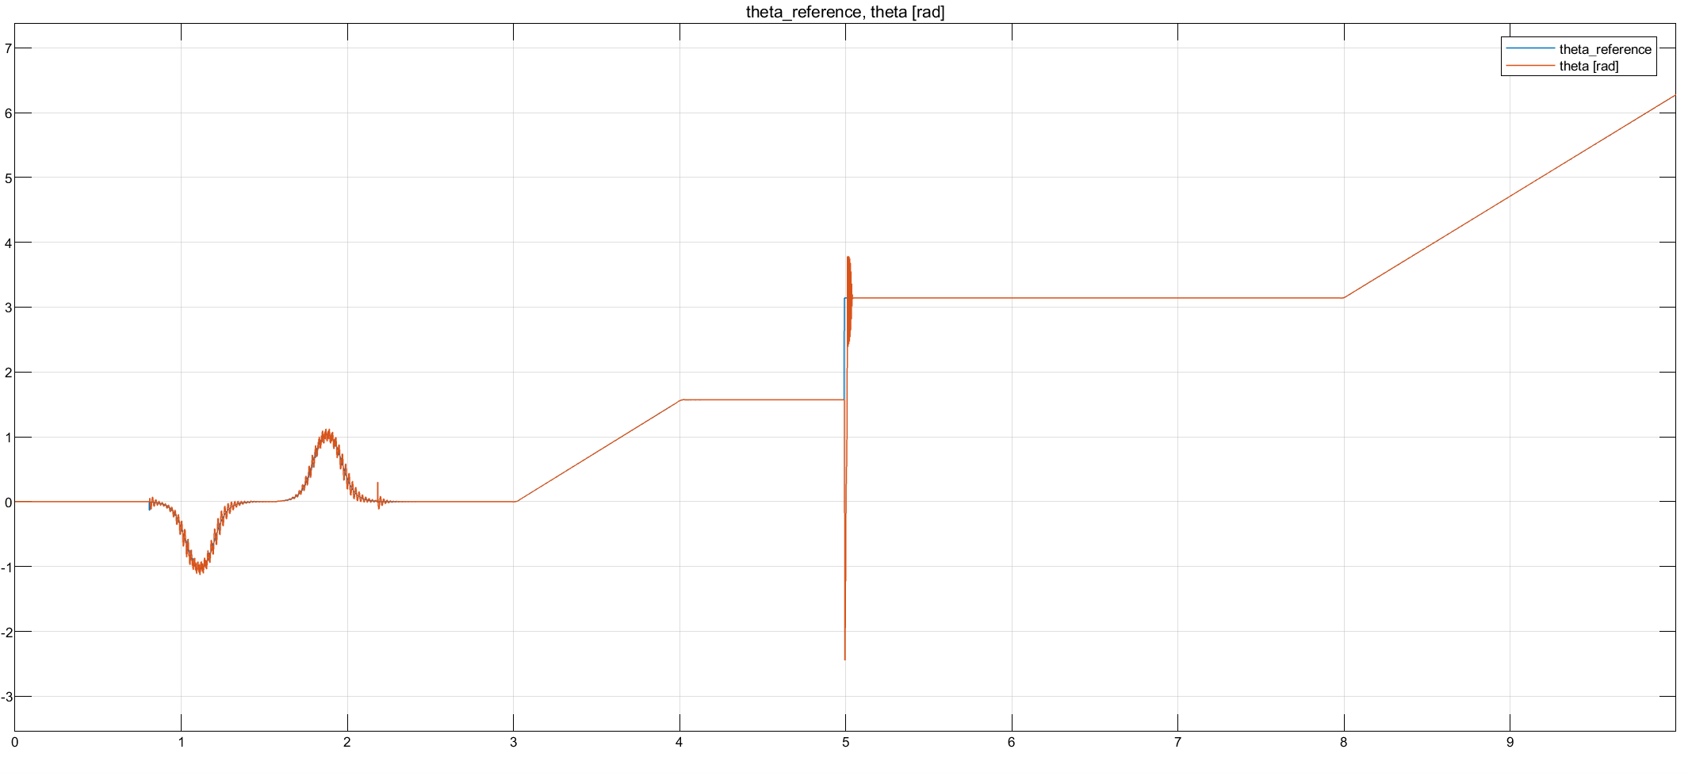
Plots --> see if impulse bigger than linear case follows some theoretical thing or just related to gains tuning

Slide 20
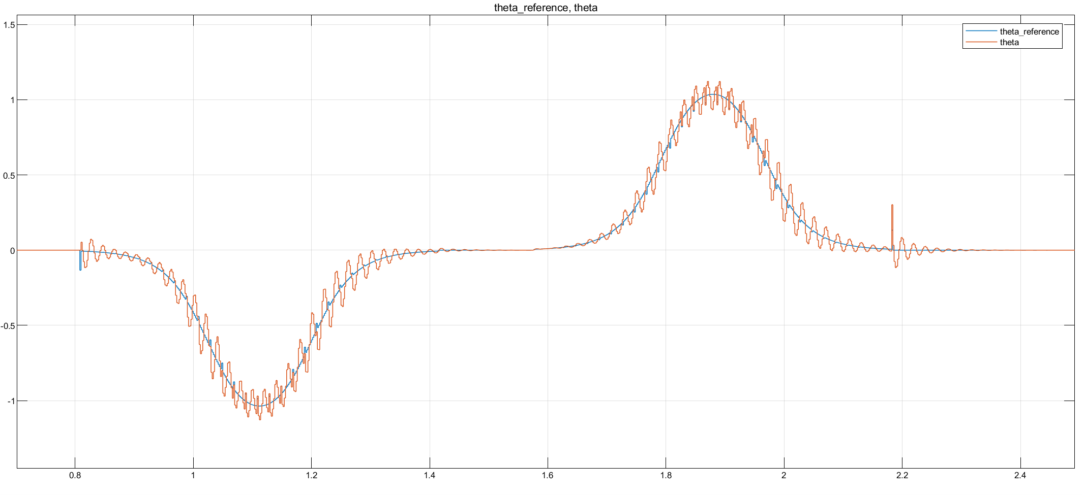

Slide 21
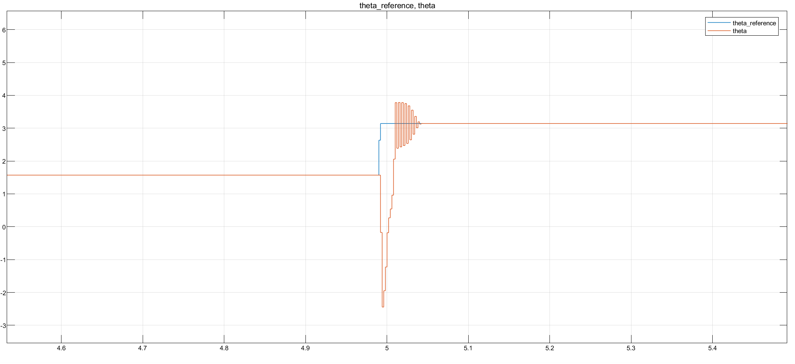
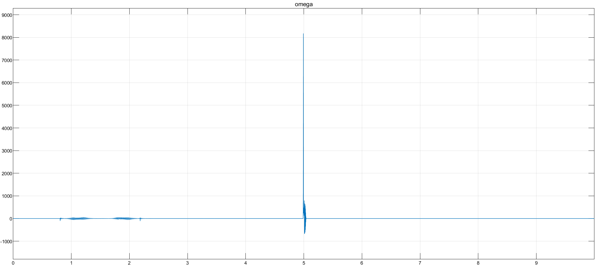
Focus on sharp curve
Make a consideration regarding NL more enhanced wrt lineare case, maybe theres a reason

Slide 22
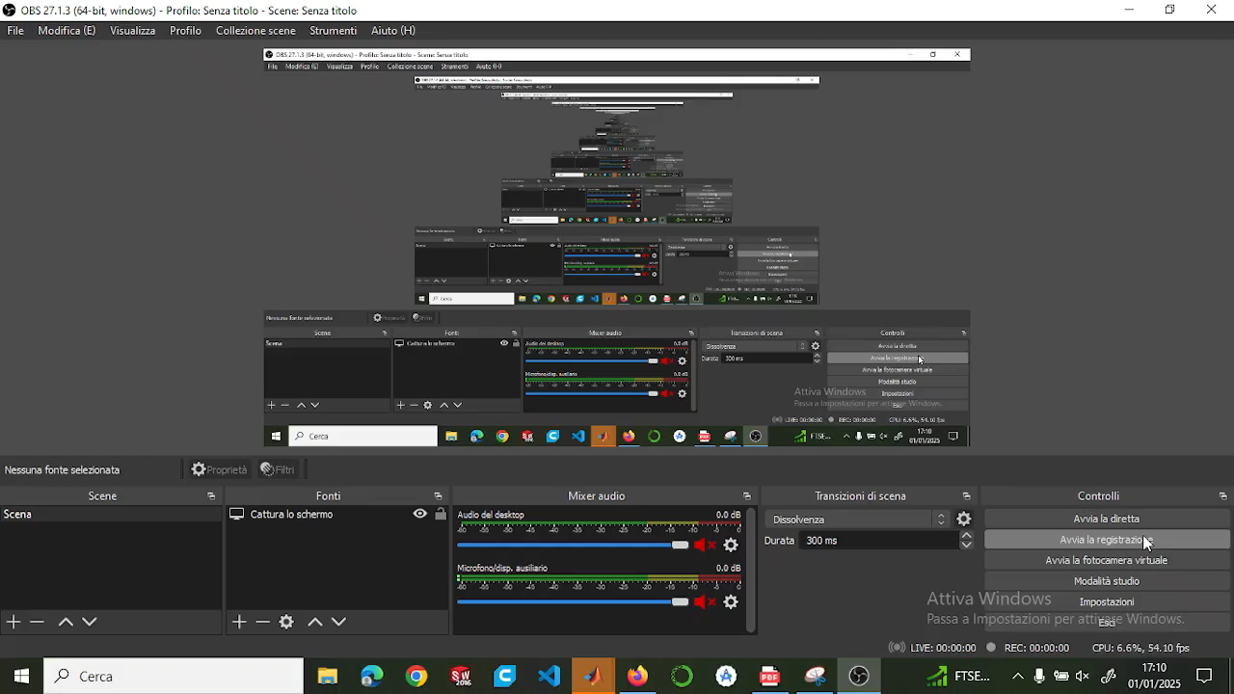
Video
Sistemare e tagliare video

Slide 23
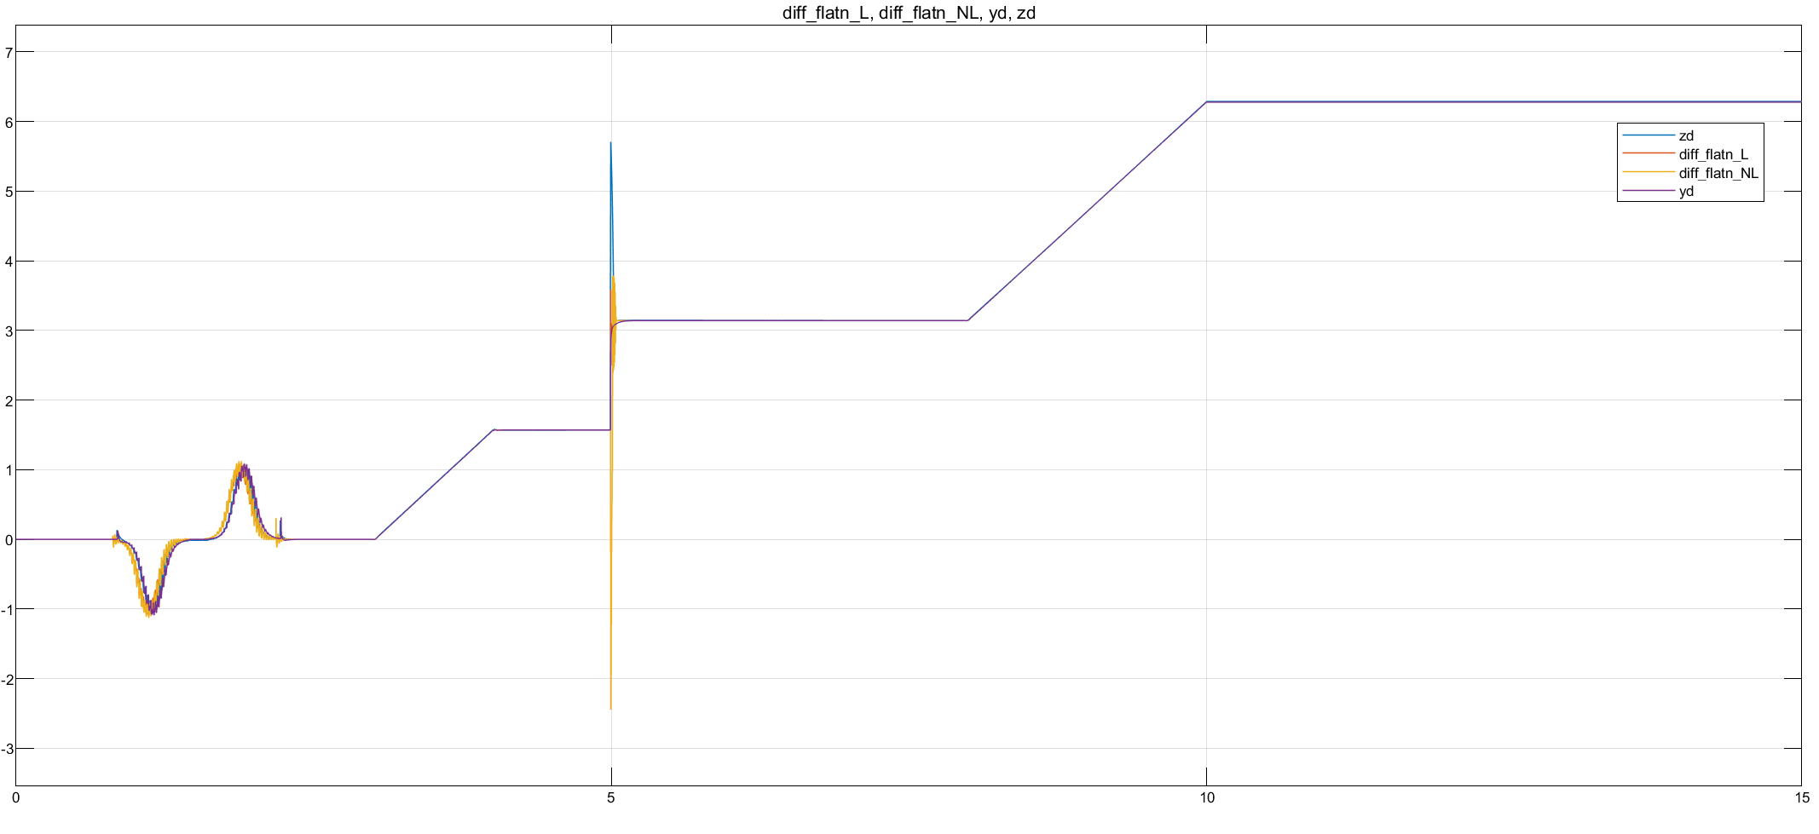
Plots of all controllers together

Slide 24
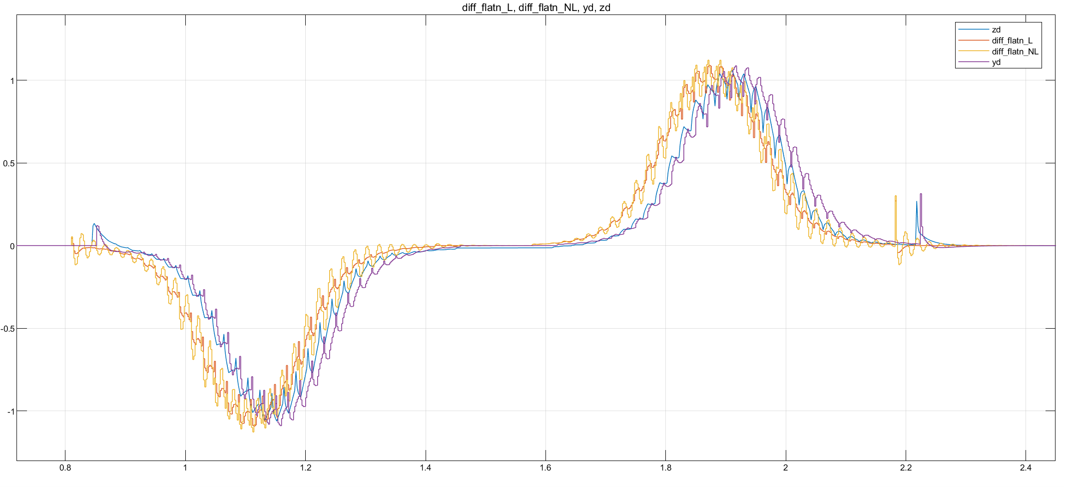

Slide 25
